Slide 1

Serverless & Containerized Food Ordering Platform
Cloud-Native Deployment on AWS Fargate
Presented By: Fatima Imran (BSSE23098), Binash Ahsan (BSSE23090), Maleeka Musadiq (BSSE23106)

Slide 2


Executive Summary
Goal
Approach
Develop a scalable web application for online food ordering.
Utilized a Serverless architecture to eliminate infrastructure management.
Key Tech
Outcome
Docker, AWS ECS (Fargate), and Amazon DynamoDB, AWS EKS And Ci/CD pipelines.
A fully functional, auto-scaling platform with a CI/CD pipeline for rapid deployment within the AWS Learner Lab.

Slide 3
The Challenge: Traditional Hosting
Scalability Issues
Operational Overhead
Regular Virtual Machines (VMs) crash during traffic spikes (e.g., Lunch rush).
Requires manual OS patching, security updates, and server configuration.
Cost Inefficiency
Complexity
You pay for the server even when no one is ordering.
Deploying updates involves significant downtime and manual file transfer.

Slide 4
Our Approach: Cloud-Native Microservices
1
Containerization
2
Serverless Compute
Packaged Frontend and Backend into Docker Containers for consistency.
Used AWS Fargate to run containers without managing servers.
3
Managed Database
4
Automation
Used DynamoDB (NoSQL) for infinite scale and zero admin.
Implemented a CI/CD Pipeline using PowerShell to automate builds and deployments.

Slide 5
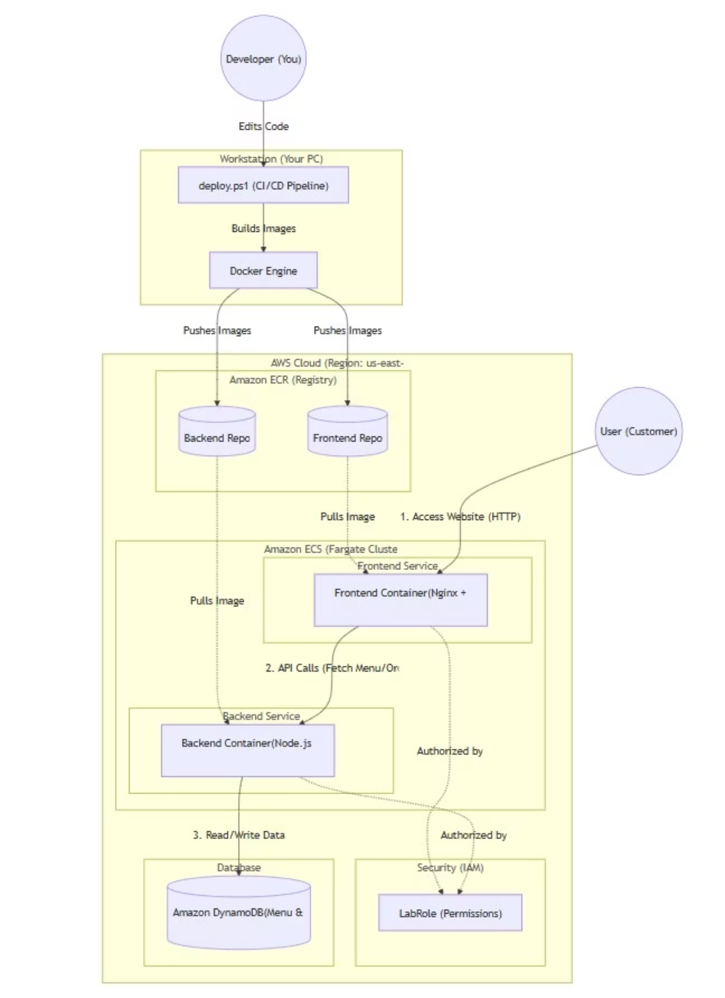
AWS System Architecture
User Interface: React App served via Nginx.
API Layer: Node.js Express Application.
Data Layer: Amazon DynamoDB (Tables: Menu, Orders).
Registry: Amazon ECR stores the Docker Images.
Security: Services run in private/public subnets with IAM Roles (LabRole).

Slide 6
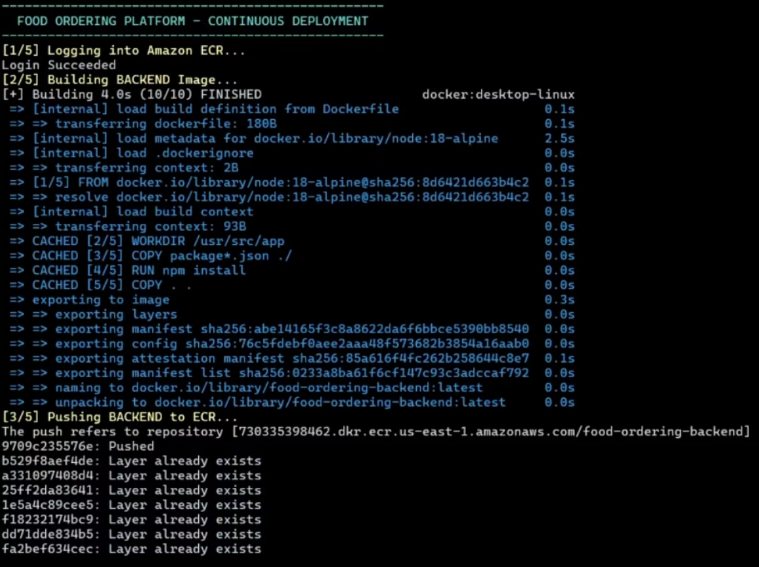

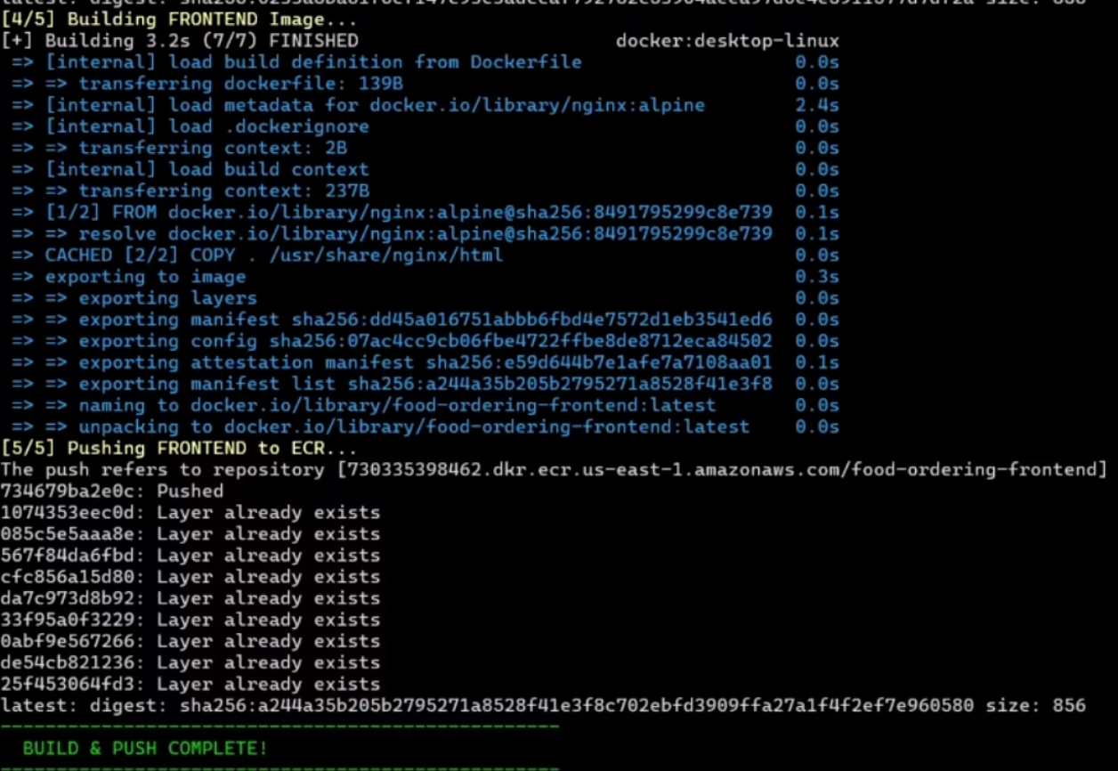
Deployment Pipeline (CI/CD)
01
Code
Developer pushes changes to local Git.
02
Build
Script triggers docker build for Frontend & Backend.
03
Push
Images are uploaded to Amazon ECR.
04
Deploy
AWS ECS detects new images and rotates the tasks.
05
Scale
Fargate provision capacity automatically.

Slide 7
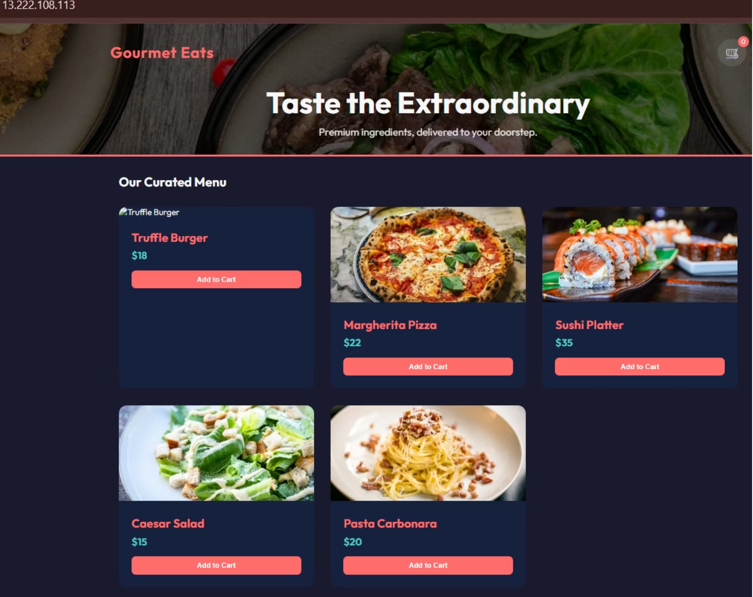
Project Outcomes & Metrics
Performance:
API Latency: < 200ms
Deployment Time: Reduced from 15m to 3m
Availability:
100% Uptime during testing (Self-healing containers).
Cost:
Zero idle cost for compute (pay-per-request model).

Slide 8


Conclusion & Future Scope
1
2
Conclusion
Future Scope
Successfully demonstrated that Serverless architecture solves the scalability and maintenance problems of traditional hosting.
Add User Authentication (AWS Cognito).
Implement Payment Gateway (Stripe/PayPal).
Add Analytics Dashboard for restaurant owners.
Thank You!

